Slide 1
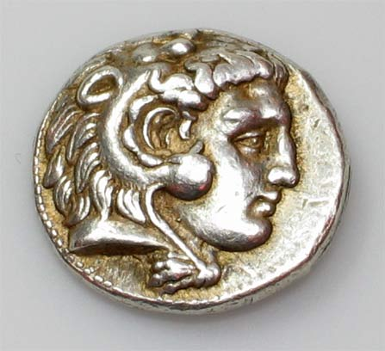
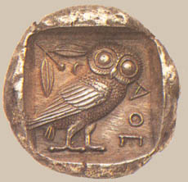
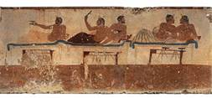
Early Greeks and The Rise of City-States

Slide 2
Geography is Important
Surrounded by sea.
Jagged coastline.
Mountainous country.
Short, rough rivers.

Slide 3
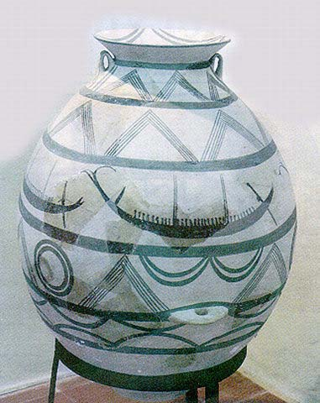
Development of Civilization
Result of this Geography:
Depended upon sea for food and commerce.
Settlements and later cities were isolated from one another.
Developed individual city-states.

Slide 4
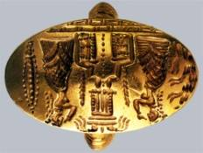
Early Greek Civilizations
The Minoans
The Mycenaeans
Earliest Greek civilization (2000-1400 B.C.).
Located on island of Crete.
Strong artistic society.
Believed to worship the bull and an Earth Goddess.
Established on Greek mainland from 1600-1200 B.C.).
Great traders and warriors.
Not as much known about Mycenaeans as is known about Minoans.

Slide 5
Early Greek People: The Minoans
Named after legendary King of Crete – King Minos.
Palace in city of Knossos on the island of Crete.
Minoan civilization known for detailed frescoes and carved figures in bronze, gold, ivory, silver and stone.

Slide 6
Minoan Civilization
Many Minoans were sailors and traders.
Set up trading posts on islands and in Asia Minor.
Trade was absolutely necessary because of the poor soil on Crete. Minoans had to trade for food.
Had a strong Navy to protect shipping.

Slide 7
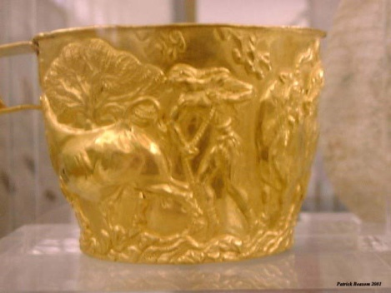
Fall of Minoan Civilization
In 1628 B.C. a volcano erupted on a nearby island.
Tidal waves (Tsunami such as hit Thailand in 2004) destroyed many coastal settlements on Crete.
Severely weakened Minoan civilization.
Around 1400 B.C. Mycenaeans conquered Crete, ending the Minoan civilization.

Slide 8
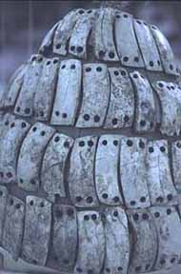
Mycenaean Civilization
Mycenaean civilization developed on the Greek mainland around 1600 B.C.
Isolation, caused by geographic features such as mountains, made unifying the various tribes into a cohesive nation-state such as Egypt very difficult.
Developed into clans and tribes, united by language and warfare against others.

Slide 9
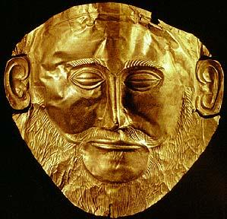
Mycenaean Civilization
Built fort-like cities in central Greece as well as in the Peloponnesus (southern part of Greece).
Carried out raids throughout eastern Mediterranean.
After conquering the Minoan civilization, the Mycenaeans adopted many of the Minoan elements.

Slide 10
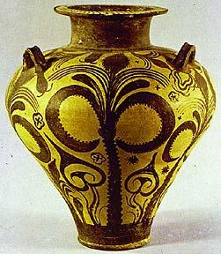
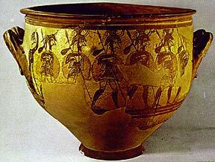
Downfall of Mycenaean Civilization
Two primary causes:
Constant warfare led to destruction of cities.
Volcanic eruptions and earthquakes.
Civilization disappeared around 1200 B.C.

Slide 11
The Dorians & the Dark Age
Came from the North & invaded the Mycenaeans.
Defeaded the Mycenaeana in 1200 B.C.
Dorians did not keep written record of history like the Mycenaeans did, so historians only know their history based on stories that were told.

Slide 12
The Dorians & the Dark Age
The Dorians ruled the land for about 400 years, we know this as the “Dark Age” because we know very little about what actually happened.
Many stories were told about the history of the Dorians, such as the legend (popular story that has been told over and over again) of The Trojan Horse. This story may or may not be true.

Slide 13
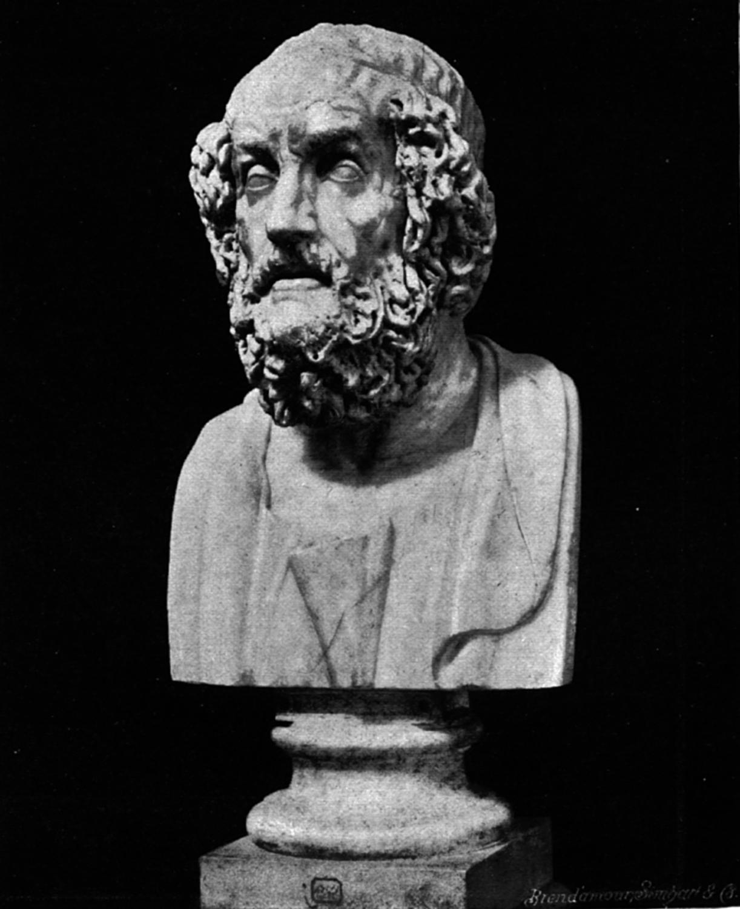
The Trojan Horse
Legend starts with poems written by the Greek poet, Homer.
Homer wrote 2 famous poems:
The Iliad & the Odyssey.
Homer writes about the infamous horse in The Odyssey.

Slide 14
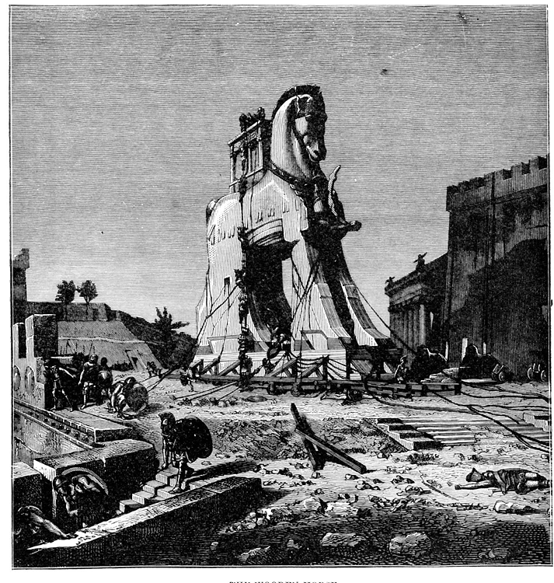
The Trojan Horse
When Homer died Virgil, a Roman poet, writes a story about the Trojan Horse after researching Homer’s poems.
This is a story of the Trojan War!

Slide 15
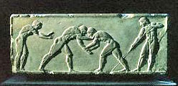
Emergence of Greek City-States
Formed between 800-700 B.C.
Each was independent of the others.
Each city-state (Greek word is Polis) developed around a fort.
Polis came to mean the fort, its city, and the lands and small farming villages which supplied its food.

Slide 16
Similarities of Greek City-States
Each covered a small area of land.
Most had a total population under 10,000, most of whom were slaves and other non-citizens.
Each city-state formed their own laws.
Only free adult males had citizenship rights.

Slide 17
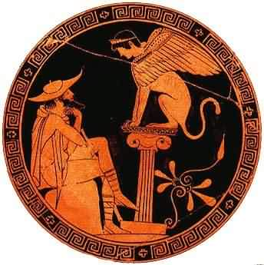
Similarities of Greek City-States
Each citizen was loyal to their polis or city-state.
All Greeks spoke the same language.
Greeks regarded anyone who spoke another language as barbarians.
Greeks shared many religious ideas, cultural characteristics and social patterns.

Slide 18
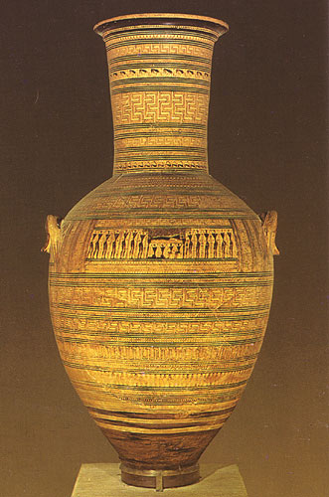
Similarities of Greek City-States
Most city-states’ forts were originally built on an acropolis, or hill.
Temples and other public buildings stood on the acropolis.
Each had an agora, or marketplace. This was also the primary meeting place of citizens.

Slide 19
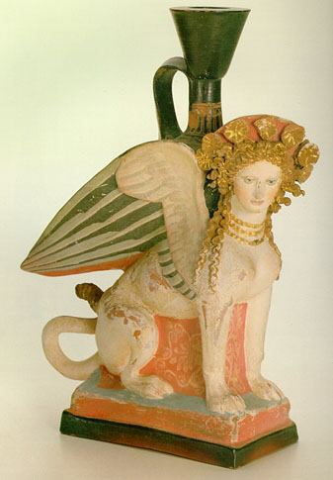
Differences in Greek City-States
All Greeks placed great value on the independence of their city-state.
Each city-state formed its own government.
Each city-state had its own calendar, money and system of weights and measures.

